Slide 1
Team GBMLR
-Hritik Jaiswal
-Priya Mane
-Pratik Merchant
-Vedang Parasnis

Slide 2
Need for the project (Why?)
Currently, people from different fields such as ideators, developers, testers & marketing people are hard to find under one roof.
Our primary objective is to bring the above mentioned type of people together under one common environment and hence reduce the hassle of finding them.
Currently, no such platform exists and hence it is our endeavour to create a multi-functionality collaborative environment.

Slide 3
About the idea (How?)
Ideator posts a idea Developer is interested in the proposed idea
Ideator approves developer Developer applies for the project idea
Ideator-Developer Collaboration starts Invite other developers & testers
Project proceeds to deployment Tester gives clearance
Marketing/ Investors Deployed in the market

Slide 4
Scope of the project
This project would help the ideators to turn their dream ideas into reality faster.
A well formed network of ideators, developers, testers and marketers would be established and would hence help bridge the gap that currently exists.
Would provide a very good opportunity for freelancers to take up short term projects and would also help students to test their practical concepts by working on a real-life project.

Slide 5
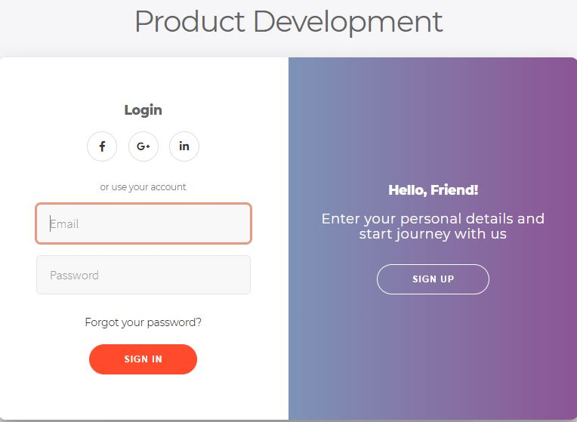
UI of our Website (Login Page)

Slide 6
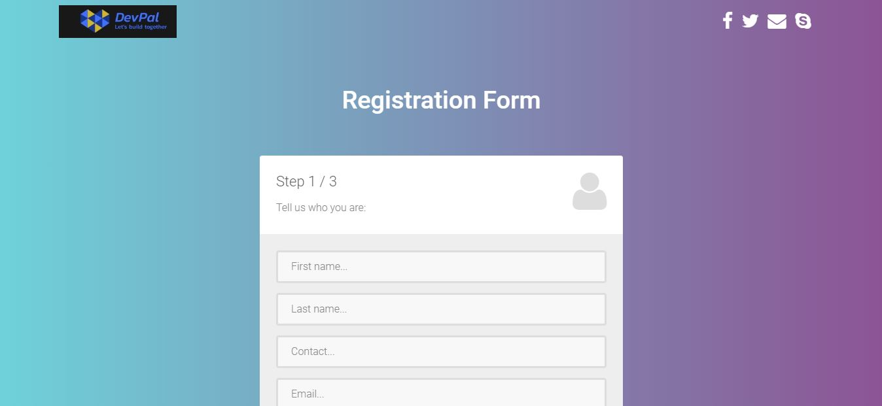
UI of our Website (Sign-up page)

Slide 7
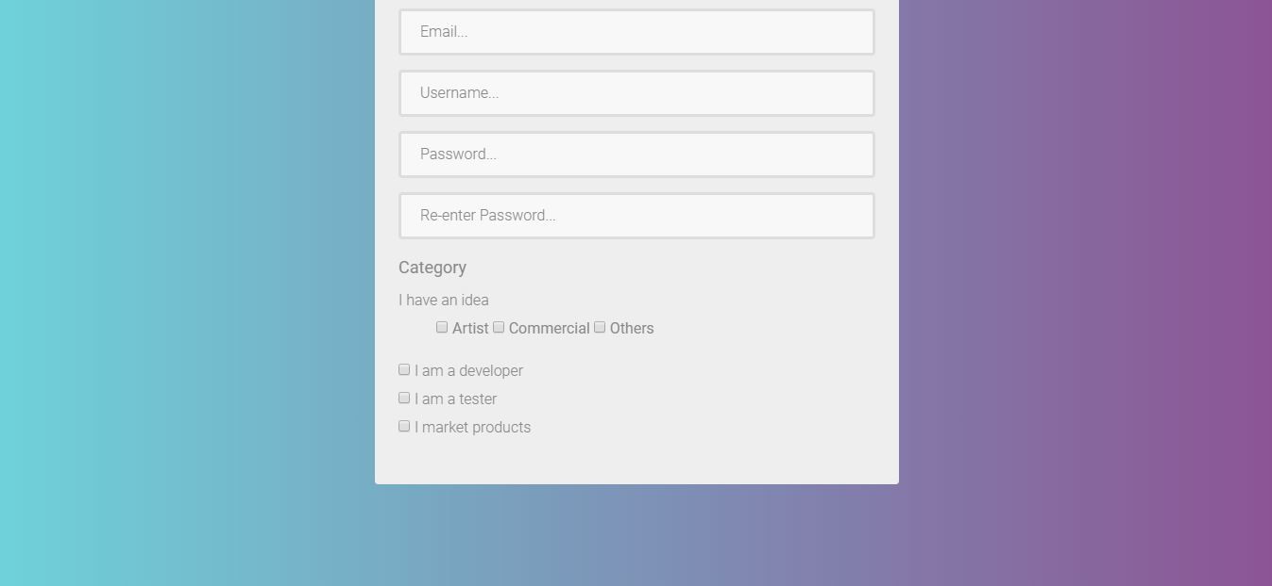
UI of our Website

Slide 8
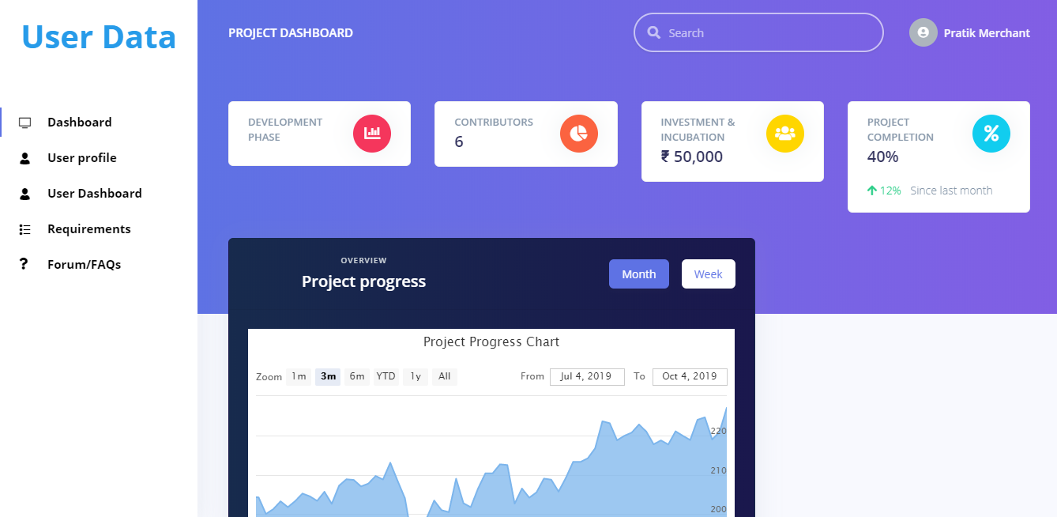
UI of our Website

Slide 9
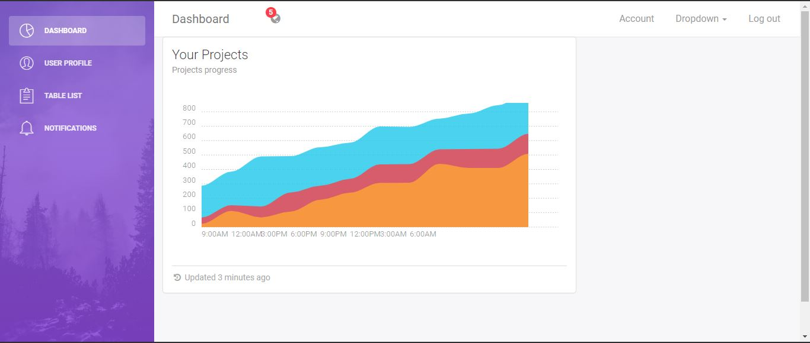
Client Dashboard

Slide 10
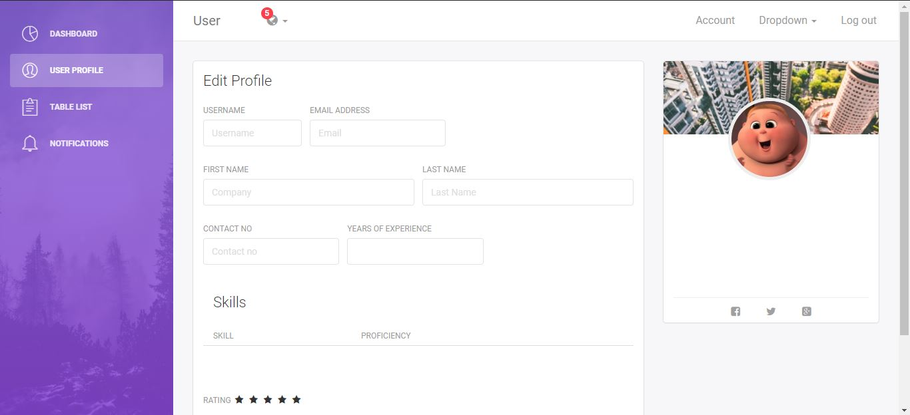
Developer Dashboard

Slide 11
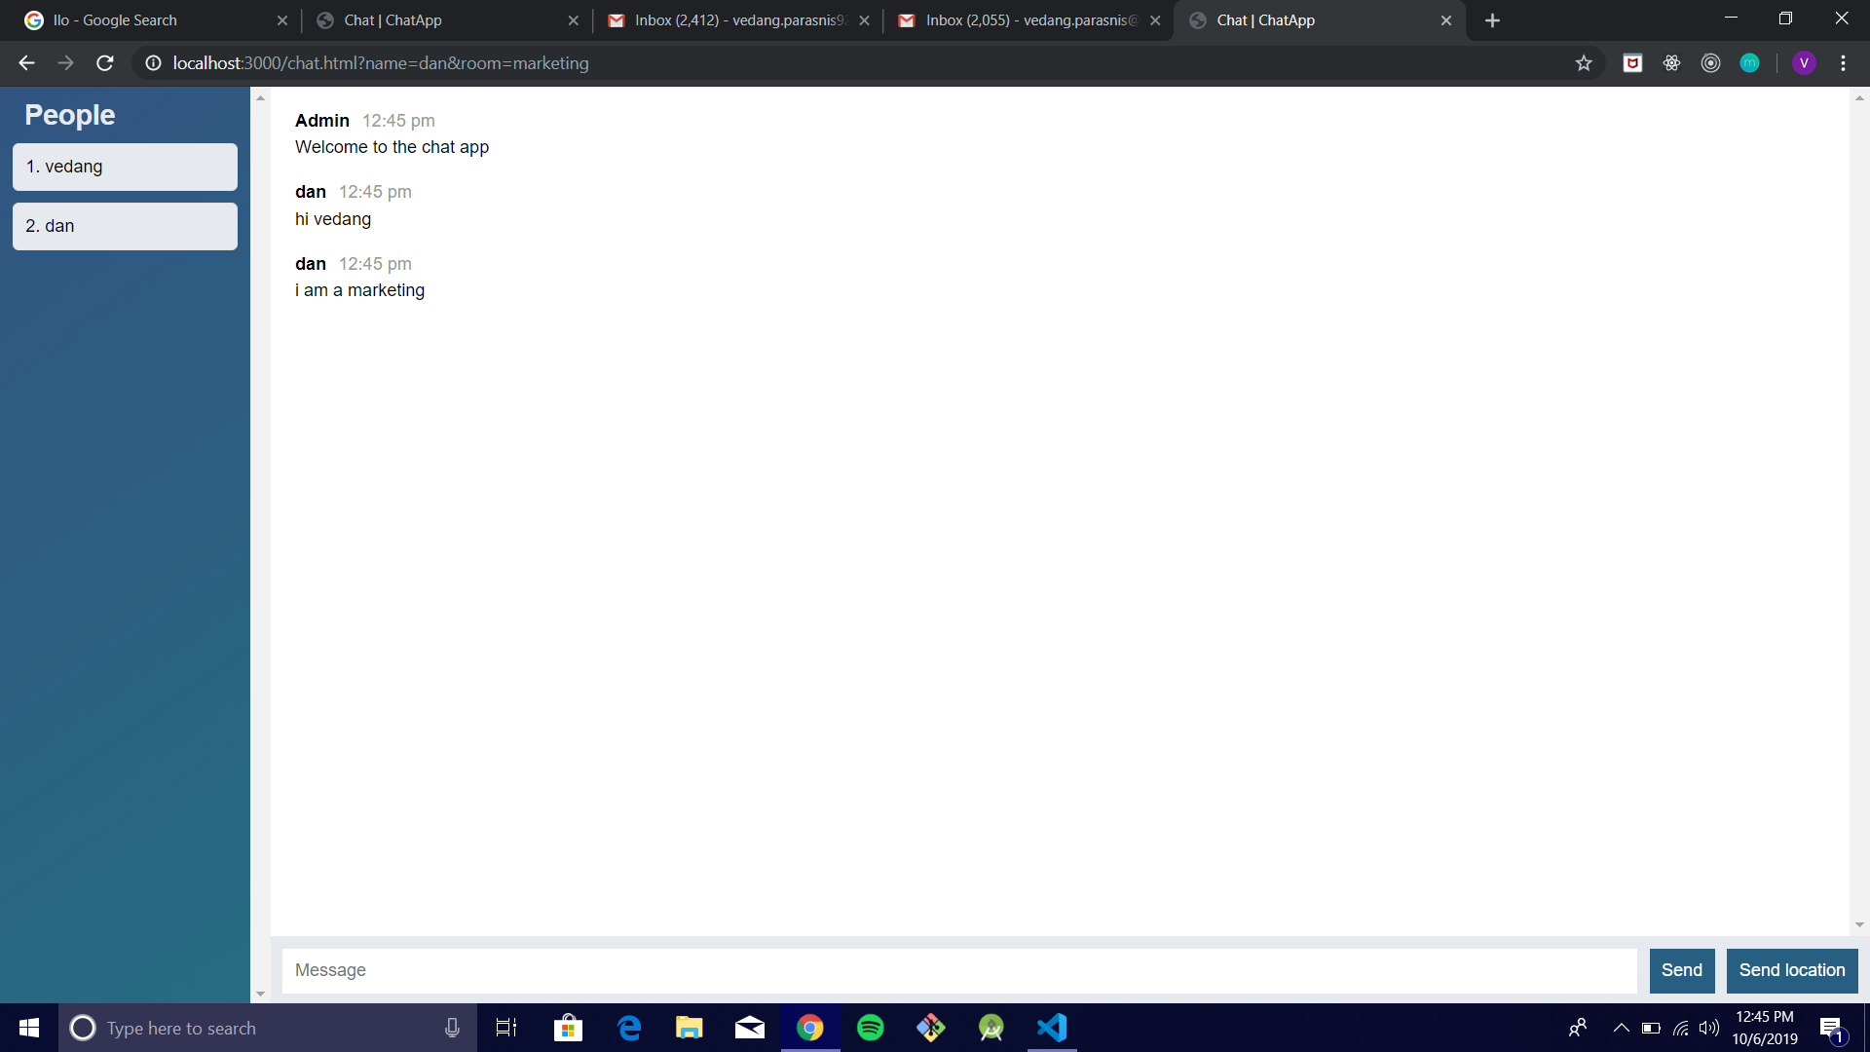
Chat Room
The Chat room designed mainly to provide efficient communication between the
stakeholders also uses the google location api to provide a sharing location option among them.

Slide 12
Server Architecture
Firebase Tools and firebase admin sdk is used to serve firebase admin.firebase cloud firestore.Firebase Storage Bucket,Firebase cloud functions
Firebase Auth
Node Server
(Rest Api)
Client (express,express=handlebars)
Firebase Cloud FireStore
Firebase functions

Slide 13
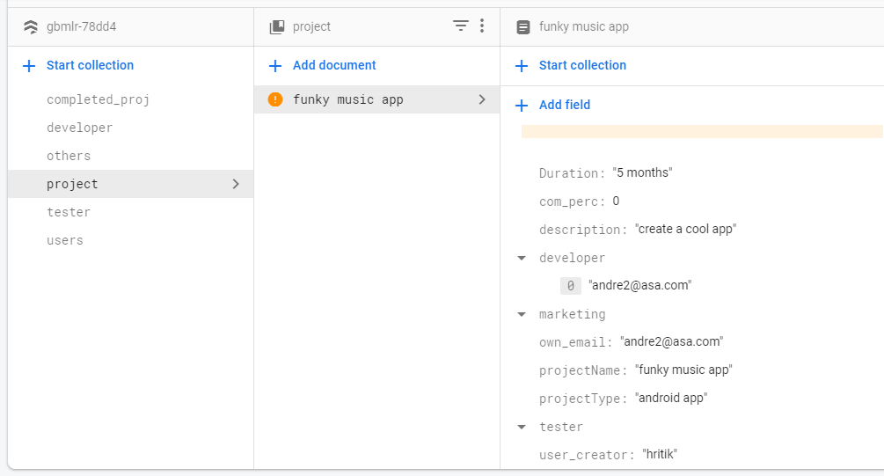
FIREBASE ARCHITECTURE

Slide 14
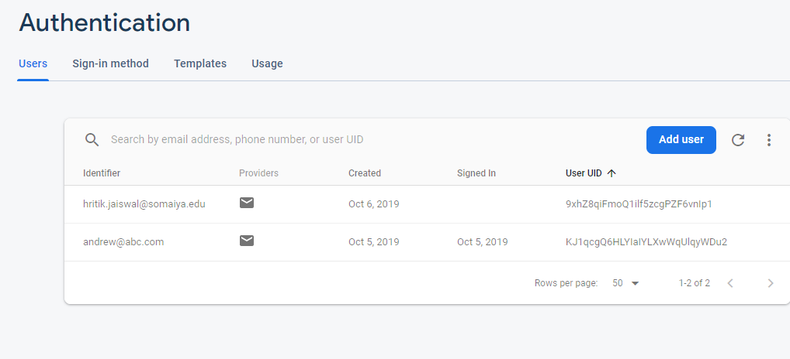
Firebase auth architecture

